Slide 1
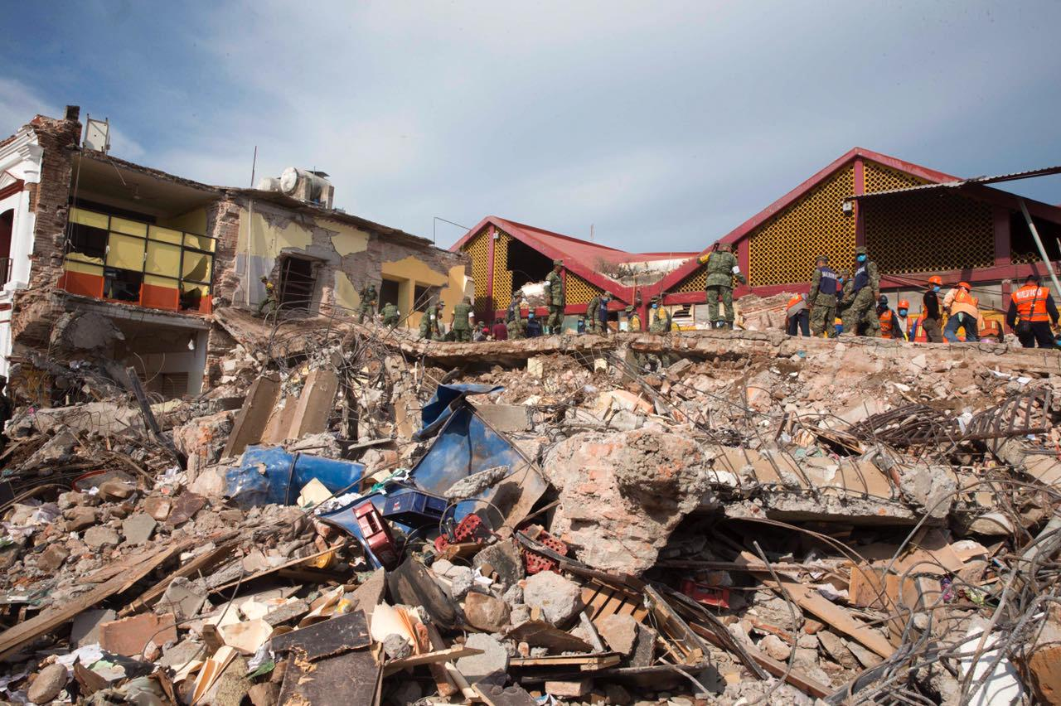
Modelling Earthquake Damage
CZ1015 Introduction to Data Science and Artificial Intelligence
Mini-Project Presentation
Chua Chiah Soon, Garg Astha, Ho Wei Yi Stanley, Nurul Afiqah Binte Arisfadzillah

Slide 2
Problem Statements
Data Exploration and Visualization | Classification model training and testing | Data Exploration and Visualization | Classification model training and testing
What are the most important factors which affect the damage grade of the buildings? | Predict the damage grade of the buildings by training the models based on the given dataset. | What are the ideal materials to be used in the construction that would suffer least damage? | Create your own building. Predict the damage it might suffer in case of earthquake.
Notes:
Identification of important features of a building that influence the level of damage caused by the earthquake
Classification of features based on correlation-based feature selection
Classification of features based on the prediction of level of damage caused to buildings from machine learning models
Specific future precautions can be taken to minimise damage caused to the buildings by future earthquakes

Slide 3

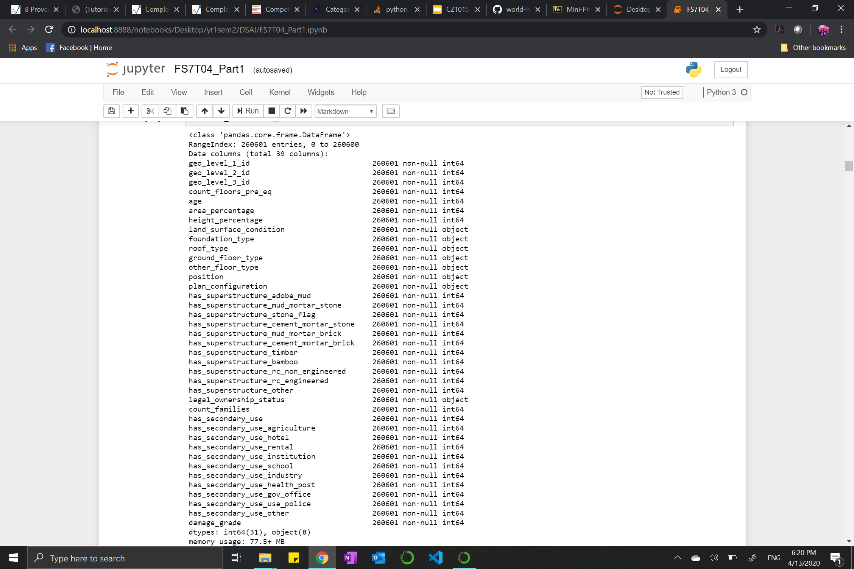
Description of the Dataset
The dataset was obtained from
The dataset consists of 39 columns (excluding building_id).
There is data available for 260,601 buildings located in Nepal.
There are no null or NaN values.
Notes:
Richter's Predictor: Modeling Earthquake Damage
Each row in the dataset represents a specific building in the region that was hit by Gorkha earthquake
train_values.csv - 39 columns in this dataset consisting of information on the buildings' structure and their legal ownership
train_labels.csv - 1 column (damage_grade) in this dataset consisting of information on the level of damage to a building that was hit by the earthquake

Slide 4
Data Exploration and Visualization
Cleaning the data to suit the needs, performing exploratory analysis and visualizations.

Slide 5
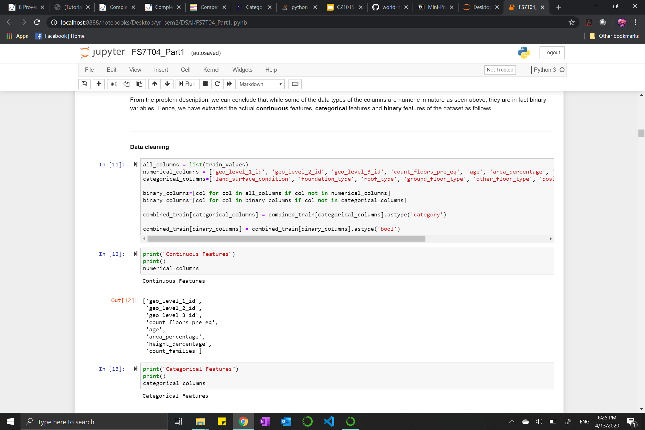
Data Cleaning
and Preparation
Removing building_id
Extracting the different columns and dummy encoding them to the desired type

Slide 6
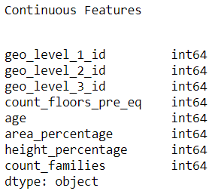
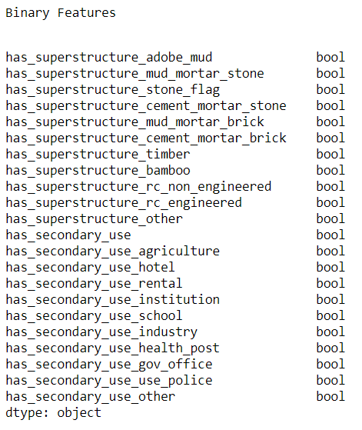
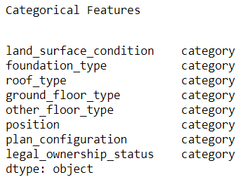
Data Exploration and Visualization
Building features
260, 601 building data entries with 3 mixed feature types
8 continuous (excluding building_id)
8 categorical
22 binary

Slide 7
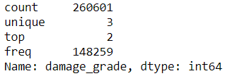
Data Exploration and Visualization
Response variable
260, 601 building data entries with ordinal type
3 ordinal classes categorisation:
1 - Low Damage
2 - Medium Damage
3 - High Damage

Slide 8
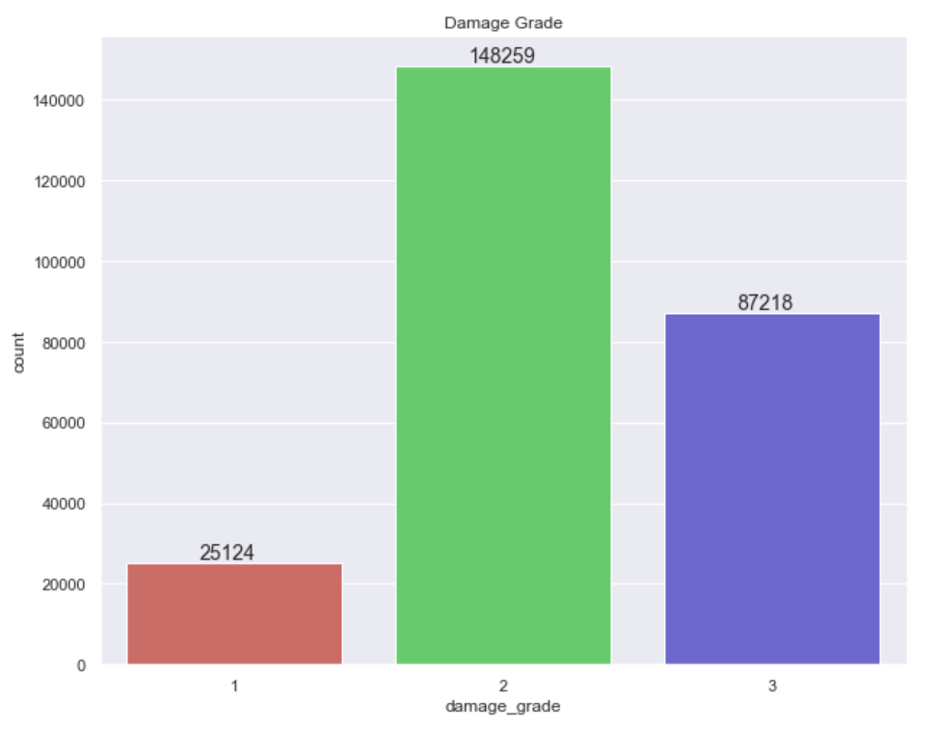
Data Exploration and Visualization
Majority of the buildings suffered medium damage
3 classes are imbalanced

Slide 9
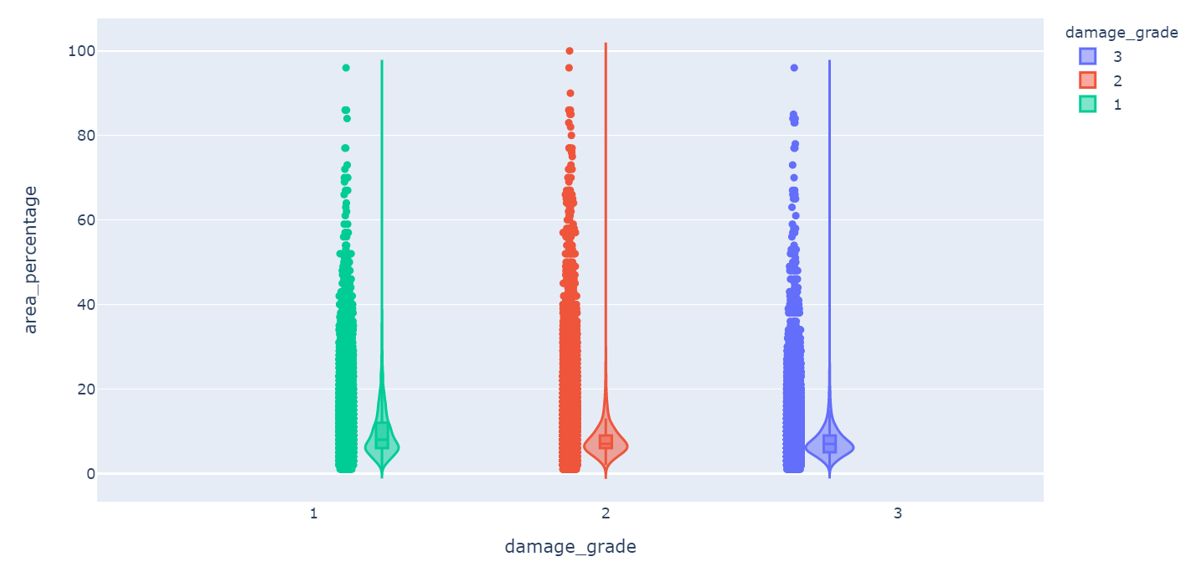
Data Exploration and Visualization
Plotting features vs damage_grade
Continuous

Slide 10
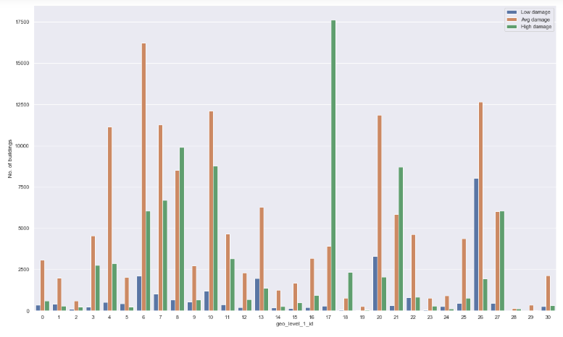
geo_level_1_id vs
damage_grade
geo_level_1_id values
8, 17, 18, 21 have more higher-damaged buildings
geo_level_1_id values
13, 20, 26 have more
lower-damaged buildings

Slide 11
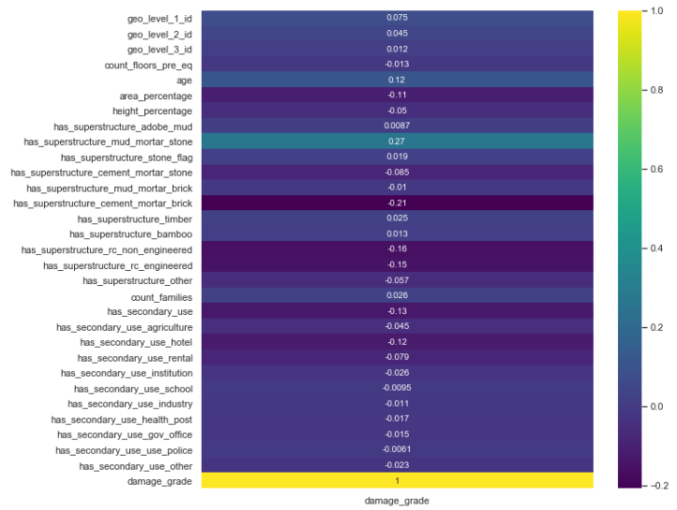
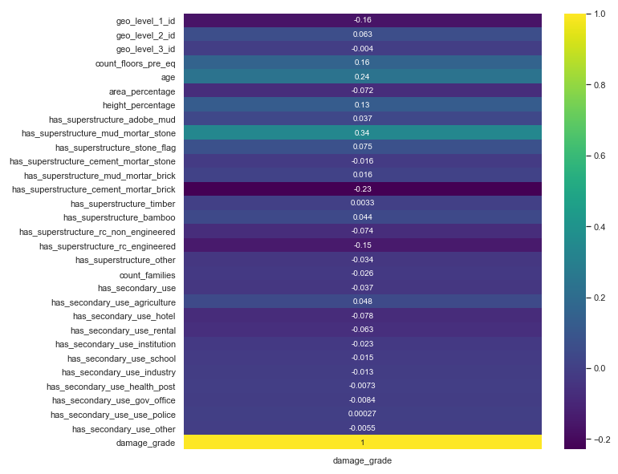
Higher-damaged
Lower-damaged
Continuous features: age, count_floors_pre_eq, area_percentage
Binary features: has_superstructure_mud_mortar_stone, has_superstructure_cement_mortar_brick, has_superstructure_rc_engineered

Slide 12
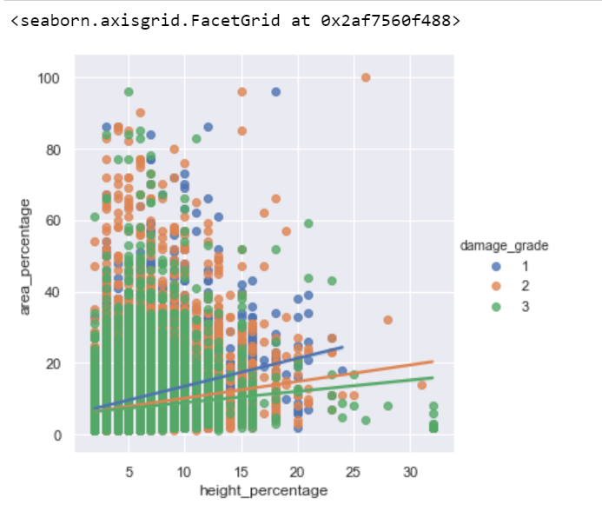
An Interesting Observation
Plotting area_percentage against height_percentage

Slide 13
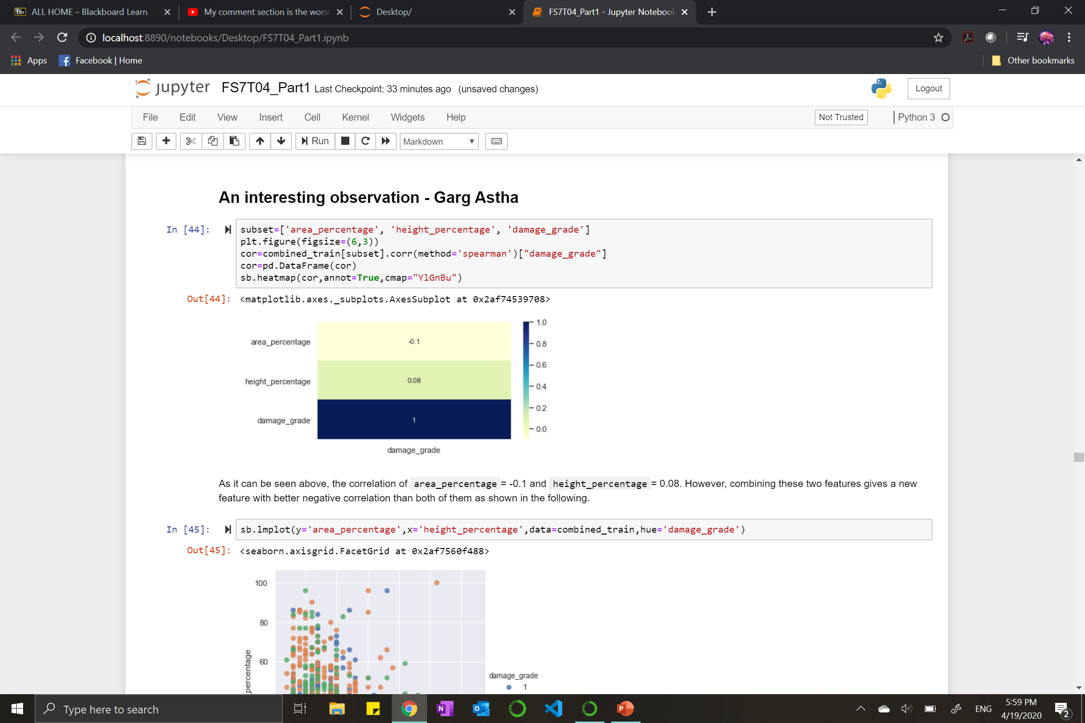
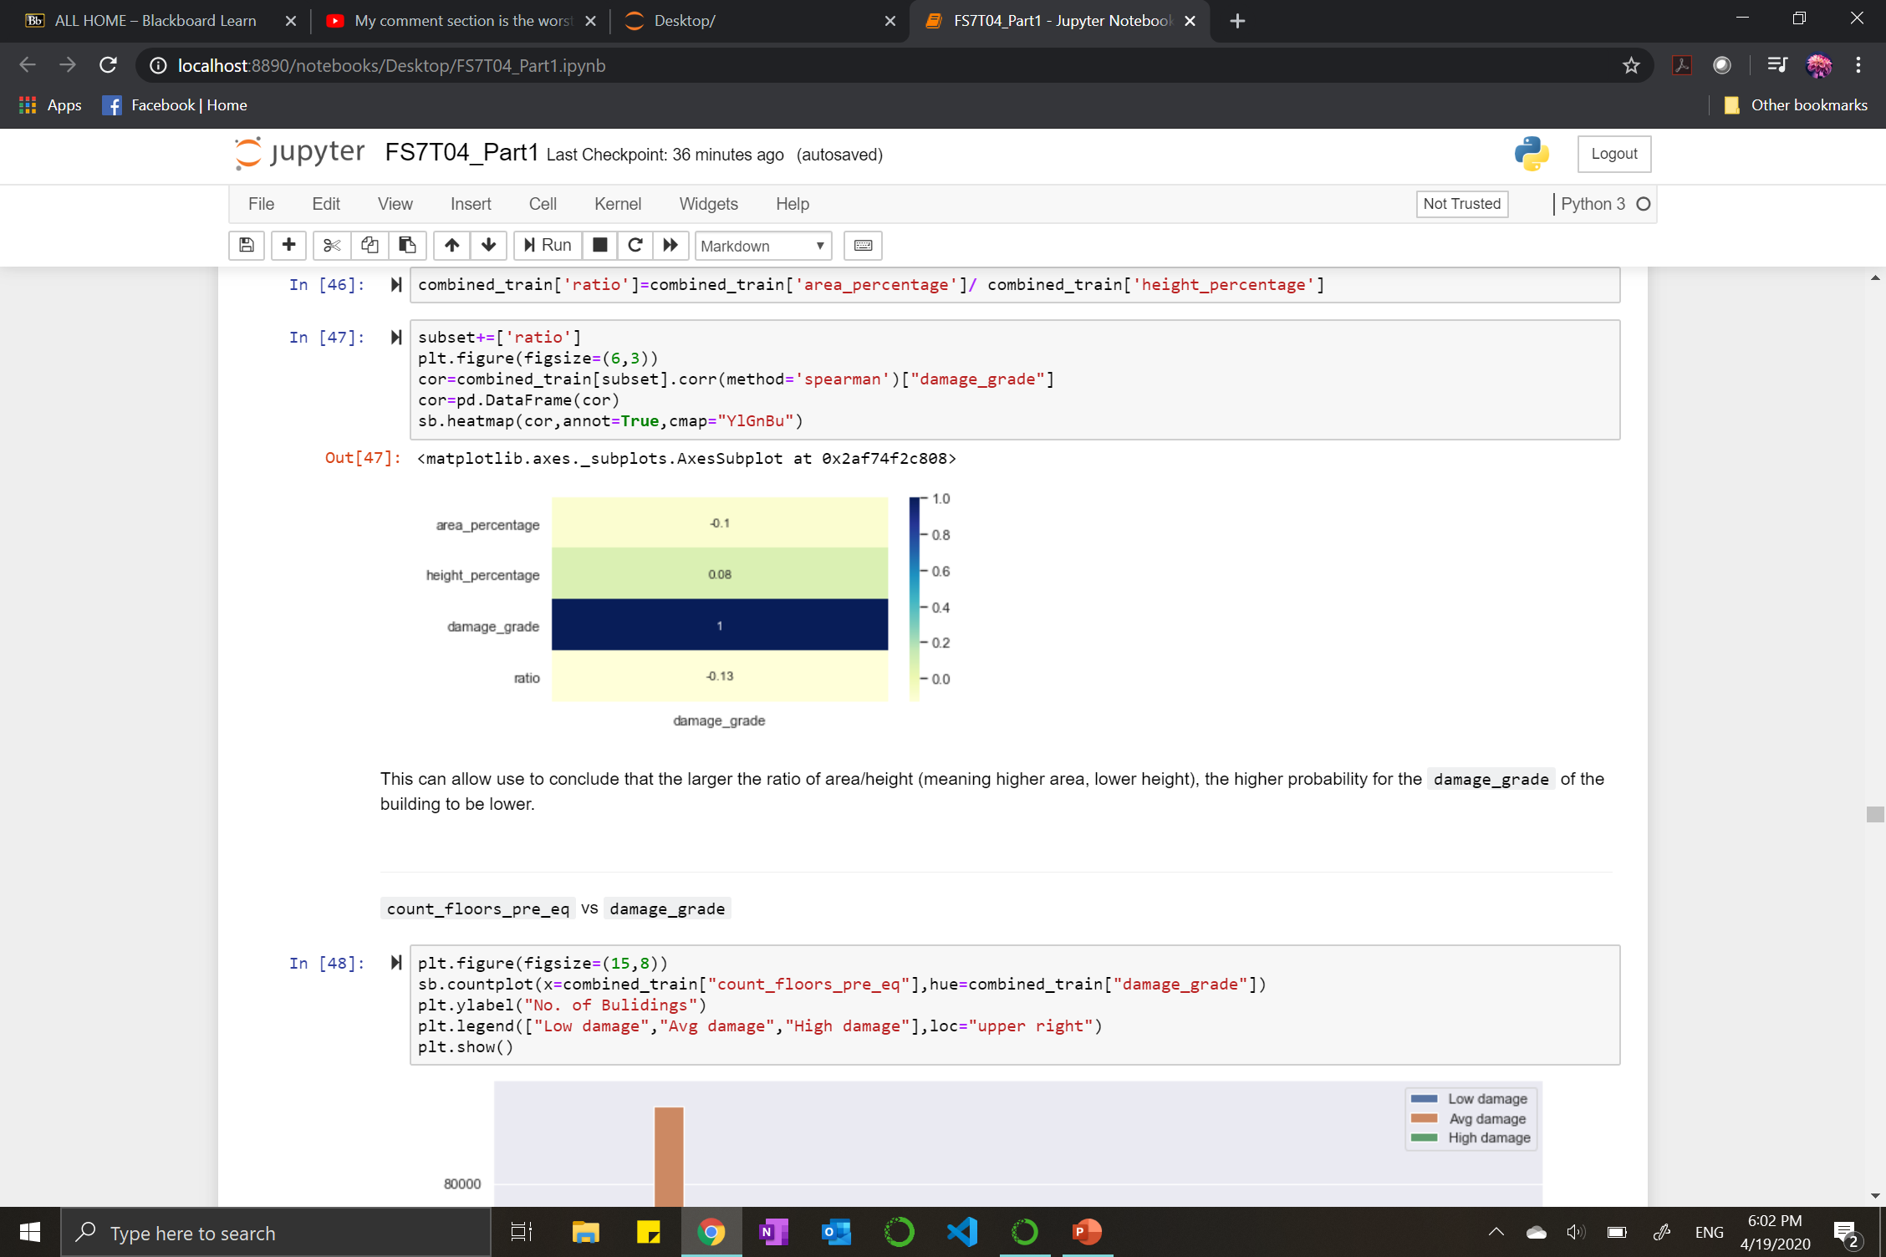
An Interesting Observation
Introducing a new variable
Ratio=area_percentage/height_percentage

Slide 14
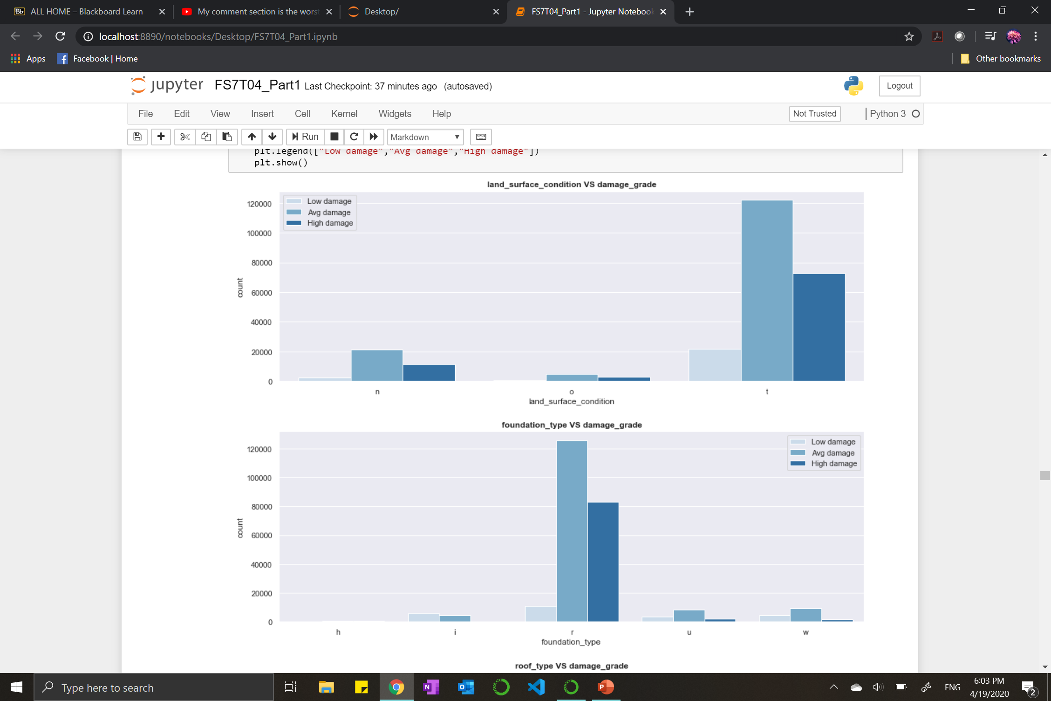
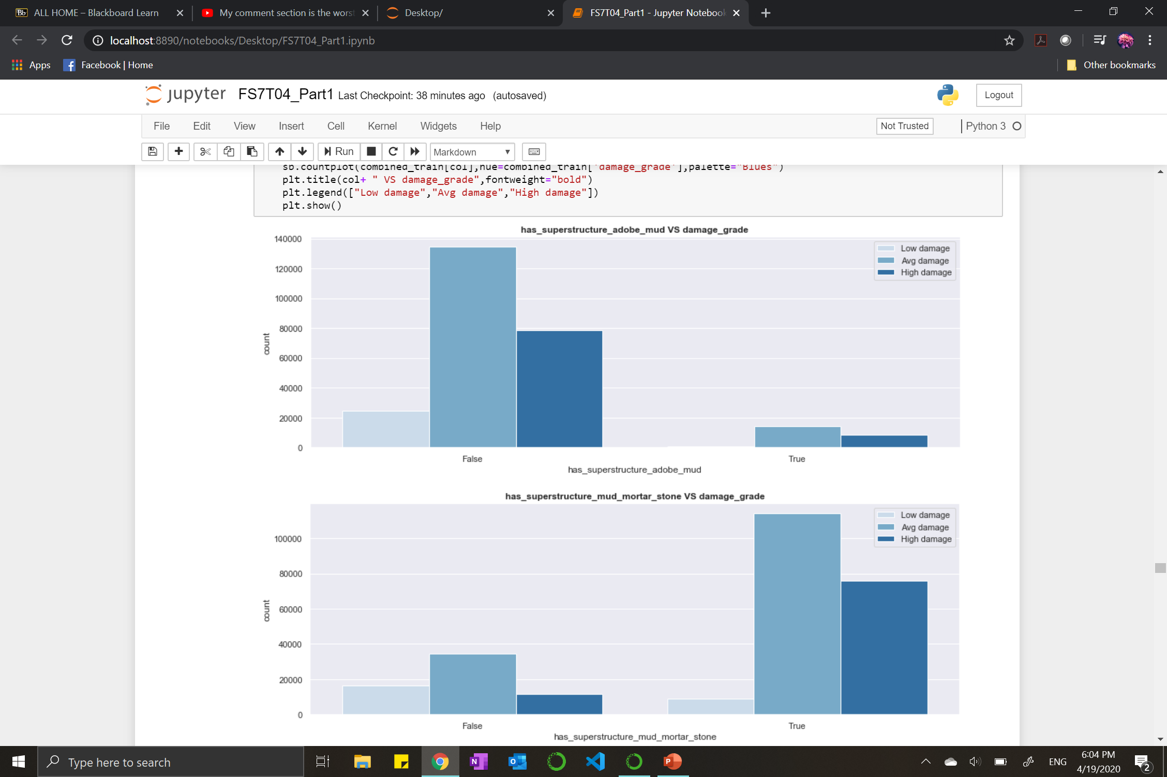
Data Exploration and Visualization
Variations in proportion for each feature
Categorical
Boolean
Highly imbalanced classes
Notes:
Categorical
Roof_type, has_superstructure_mud_mortar_stone, has_superstructure_cement_mortar_stone
Continuous
Count_floors_pre_eq, count_families

Slide 15
Statistical Analysis
Selecting the most important features that affect the damage.

Slide 16
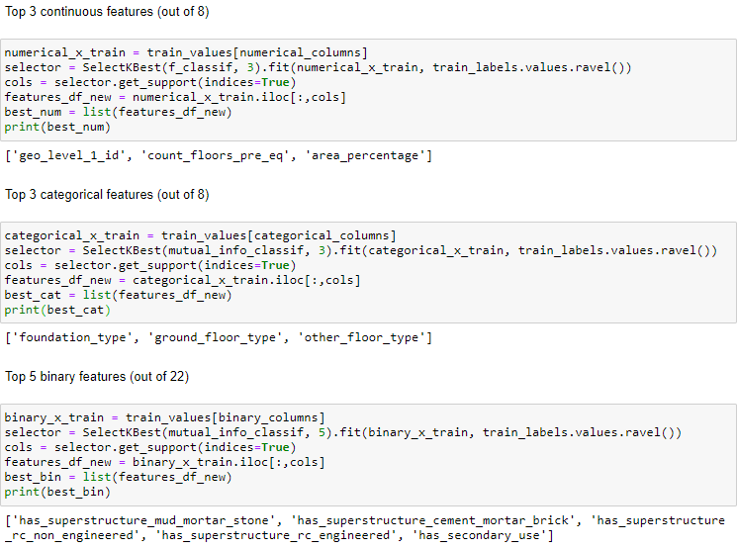
Statistical Analysis
Feature selection
Continuous features
F_test
Categorical/Boolean features
Mutual Information

Slide 17
Machine Learning
Training models and predicting the damage grade of buildings.

Slide 18
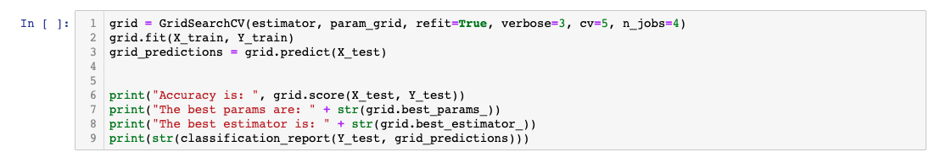
Machine Learning
GridSearchCV
Optimise results by selecting hyperparameters from pre-defined “grid” of values
Cross Validation to ensure reliable results

Slide 19

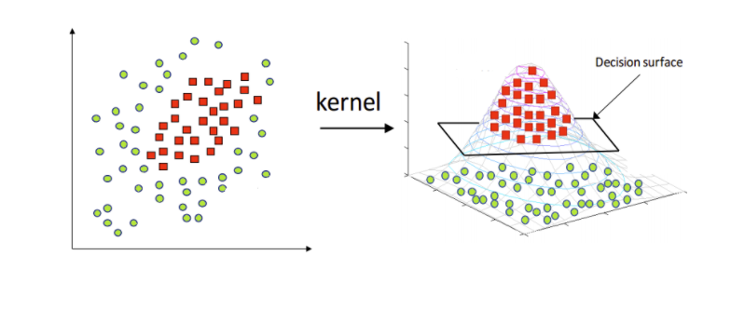
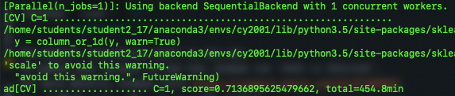
Machine Learning
Support Vector
Machine (SVM)
Supervised ML technique
Parameters
C, Kernel, Gamma
Data Preparation
One-Hot Encoding
Please Note- The code for SVM is in a .py file. It took a long time to compute so we could not integrate it with the .ipynb notebook.
Notes:
Kernels
Increase dimensionality of data to allow non-linearity in the hyperplane
Linear, Gaussian (rbf), etc.
C
Regularisation parameter
Gamma
Kernel Coefficient

Slide 20
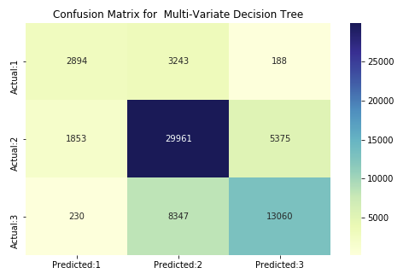
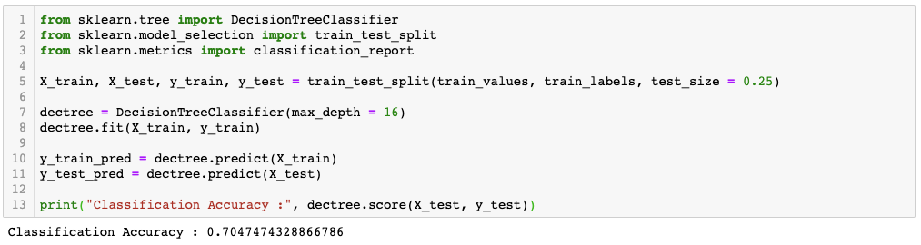
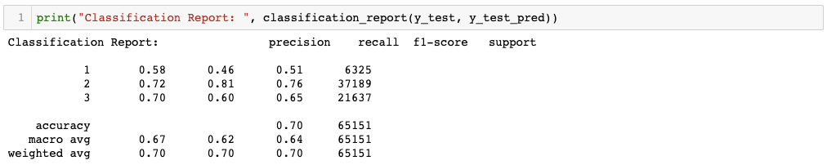
Machine Learning
Predicting damage
grade
Multivariate Decision Tree

Slide 21
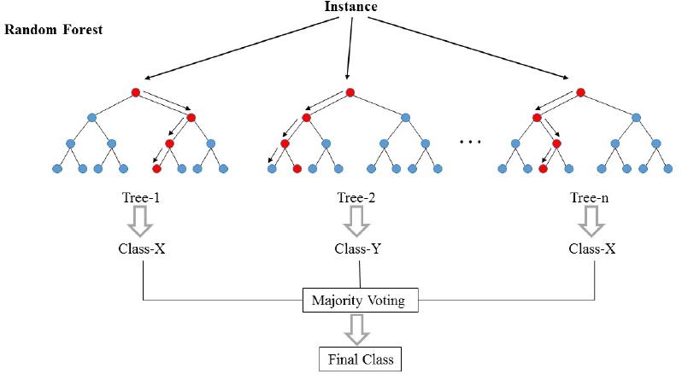
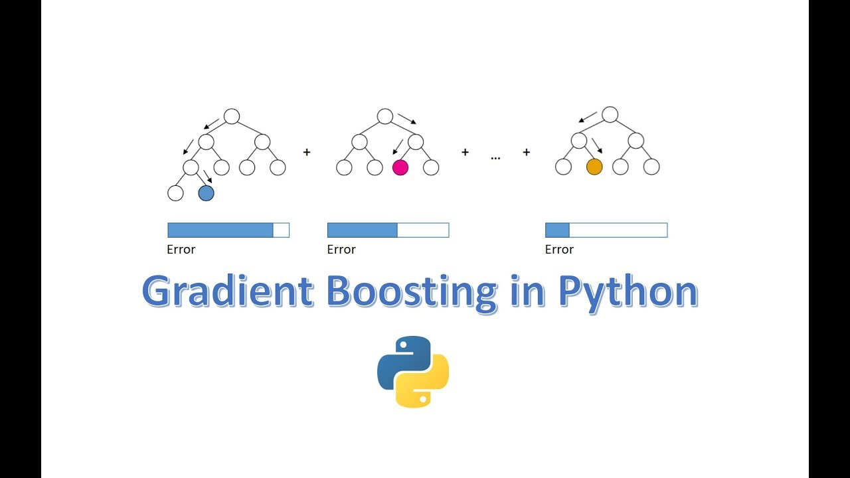
Machine Learning
Ensemble methods
Random Forest Classifier | Gradient Boosting Classifier
An accuracy of ~72% is achieved. | An accuracy of ~68% is achieved from GradientBoosting and ~74% from XGBClassifier (with GridSearchCV).
[1] https://tex.stackexchange.com/questions/503883/illustrating-the-random-forest-algorithm-in-tikz
[2] https://sefiks.com/2018/10/04/a-step-by-step-gradient-boosting-decision-tree-example/

Slide 22
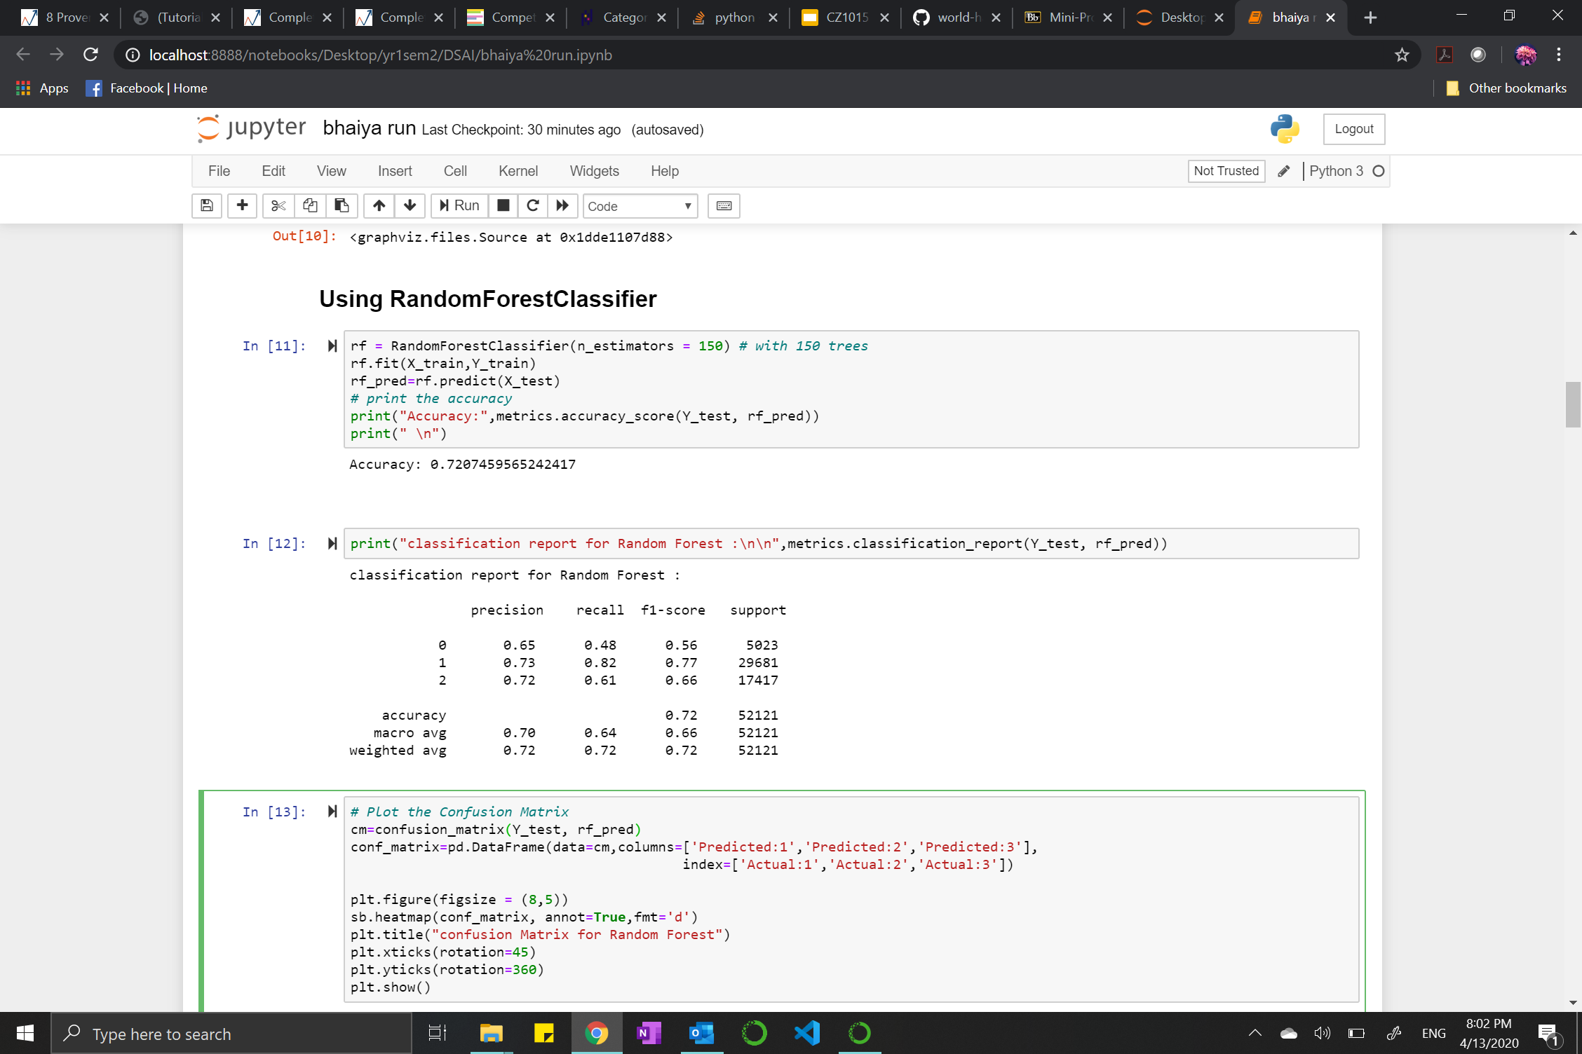
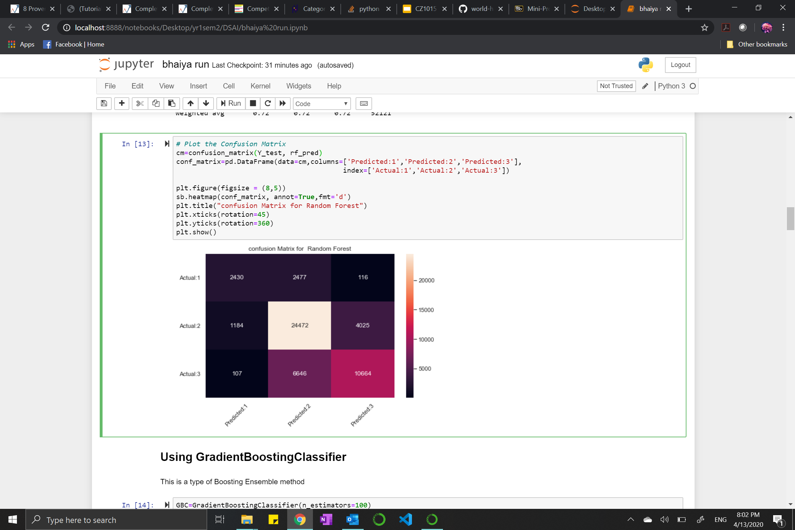
Machine Learning
Random Forest
Confusion Matrix
n_estimators: Number of trees in the forest

Slide 23
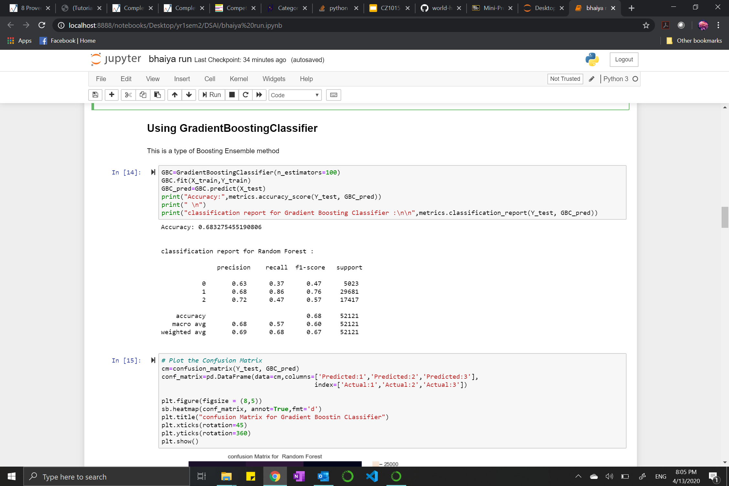
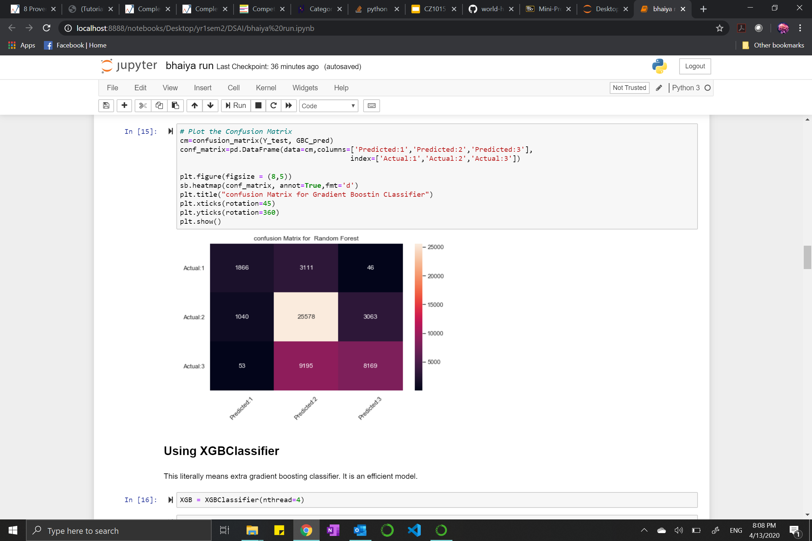
Machine Learning
Gradient Boosting

Slide 24
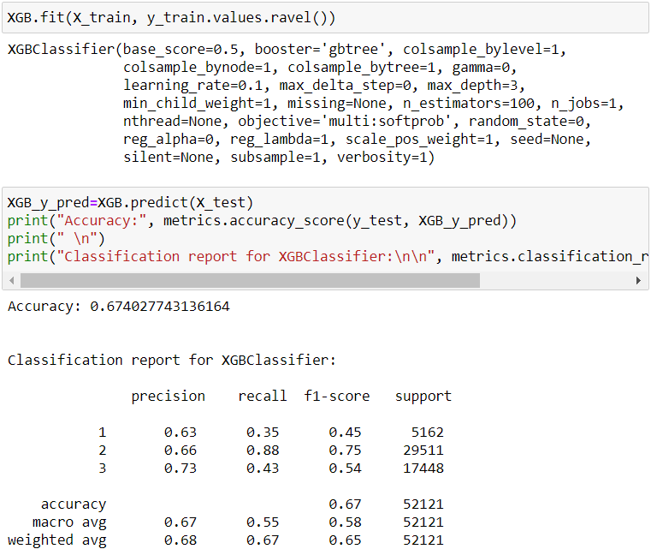
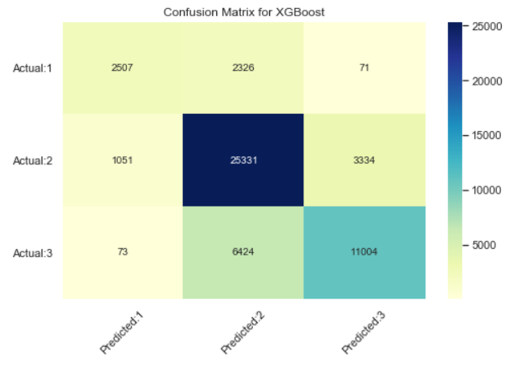
Machine Learning
XGBClassifier
‘Regularized boosting‘ technique
Implements parallel processing

Slide 25
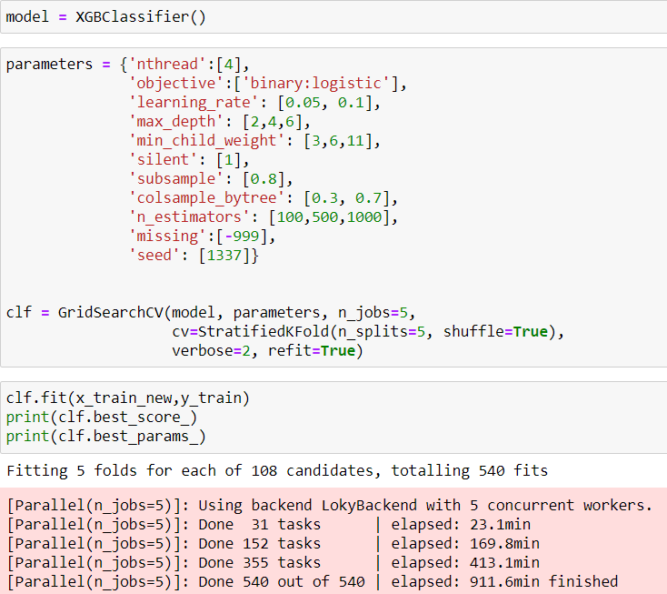
Machine Learning
GridSearchCV example
After fine-tuning of hyperparameters from the grid shown
=> Accuracy score improved
Before:
After:
Optimal parameters:

Slide 26
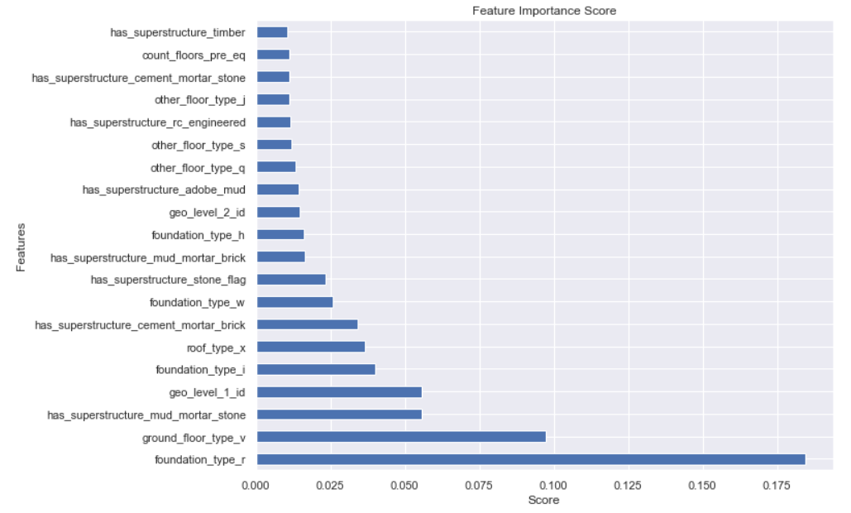
Feature
Importance
Top 20 factors (in categories) affecting damage grade (in ascending order from top to bottom) using model with highest accuracy score (XGBClassifier)

Slide 27
Which building materials suffer least damage from earthquake?
Choosing the ideal materials that sustain least damage.

Slide 28
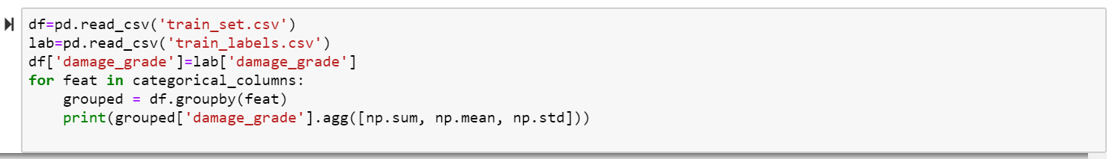
Data Exploration
Ideal Materials
The ‘ideal’ materials identified are -
land_surface_condition = t
foundation_type = i
roof_type = x
ground_floor_type = x
other_floor_type = s
has_superstructure = cement_mortar_brick and rc_engineered

Slide 29
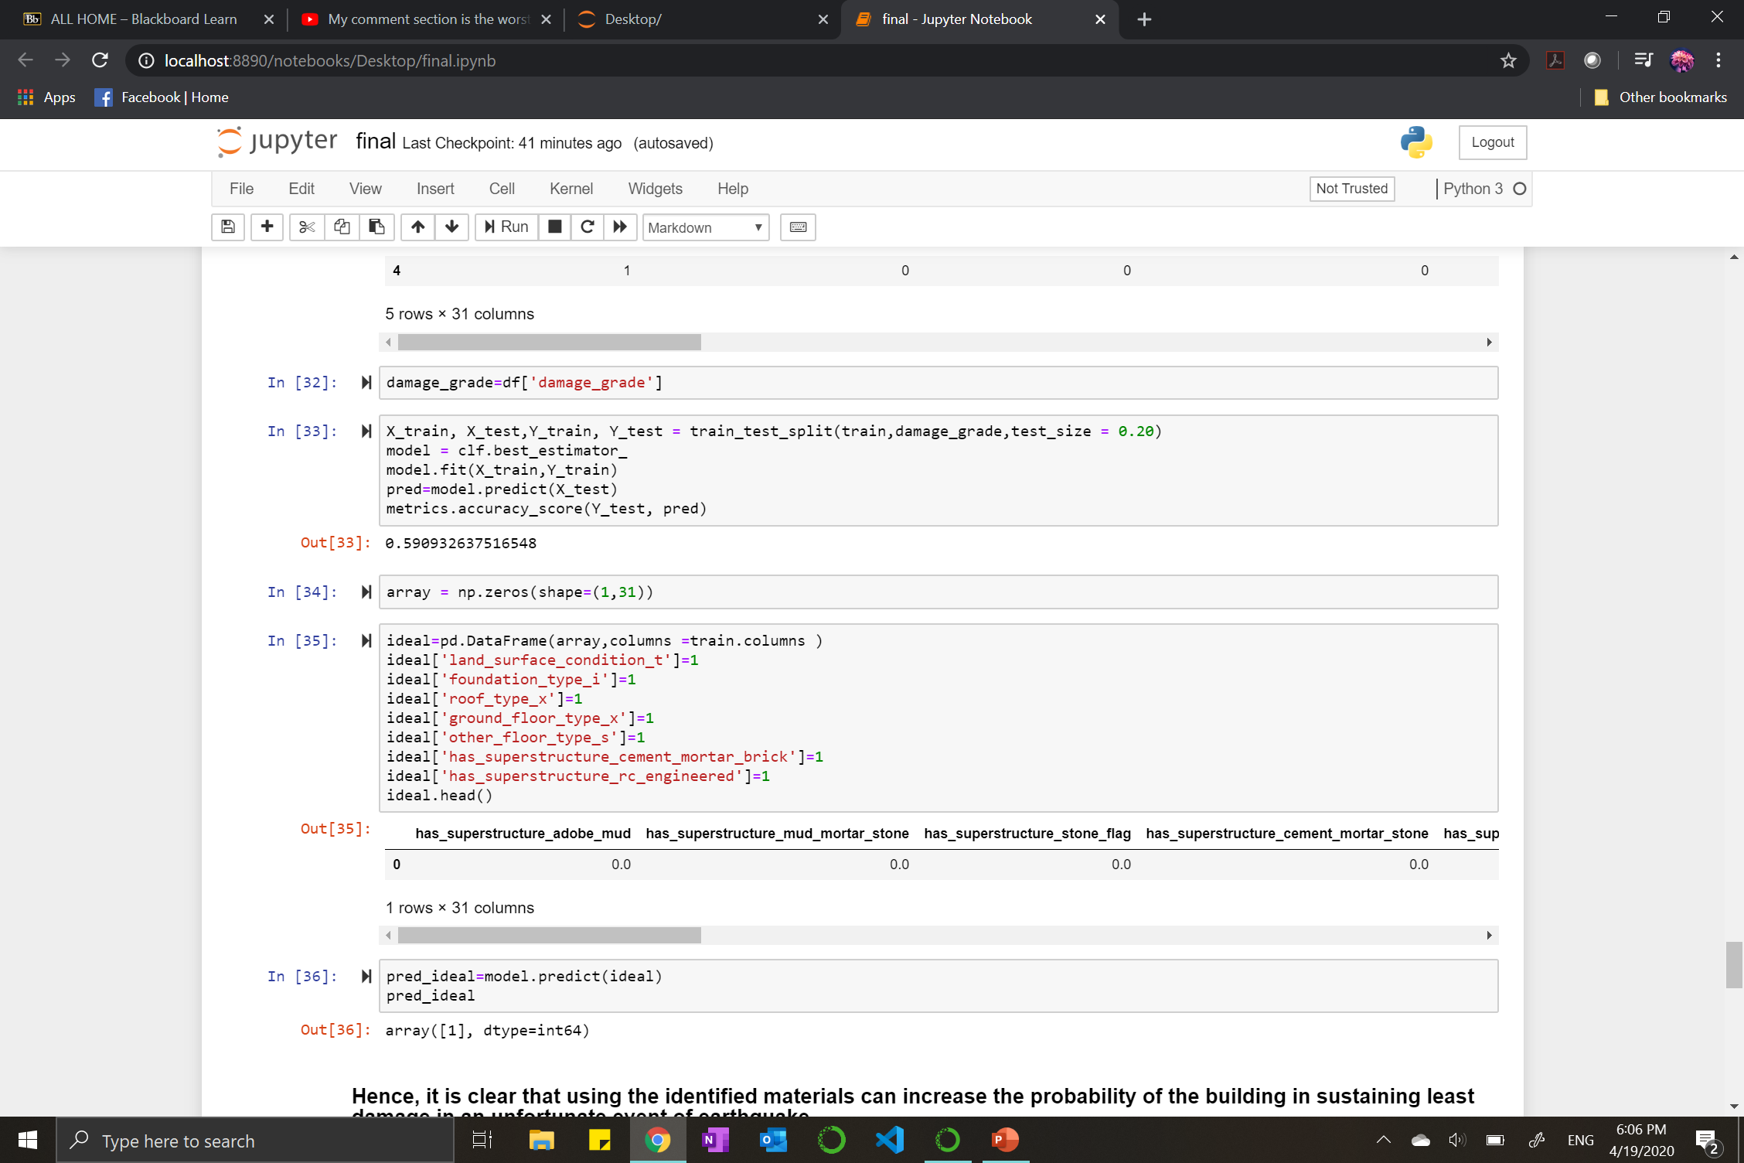
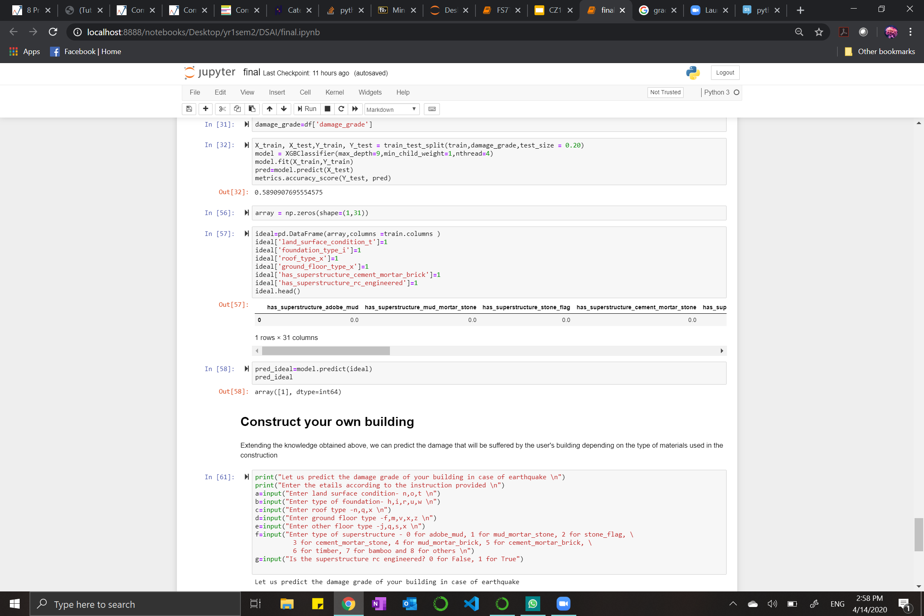
Data Exploration
Ideal Materials
Training the dataset using only the columns related to materials.
Predicting the damage grade of the building with the ideal materials irrespective of the location using the model trained earlier.
The predicted damage grade comes out to be 1 (Low Damage).

Slide 30
Construct your own building
Asking the user to input materials being used in the construction to predict the damage grade.

Slide 31
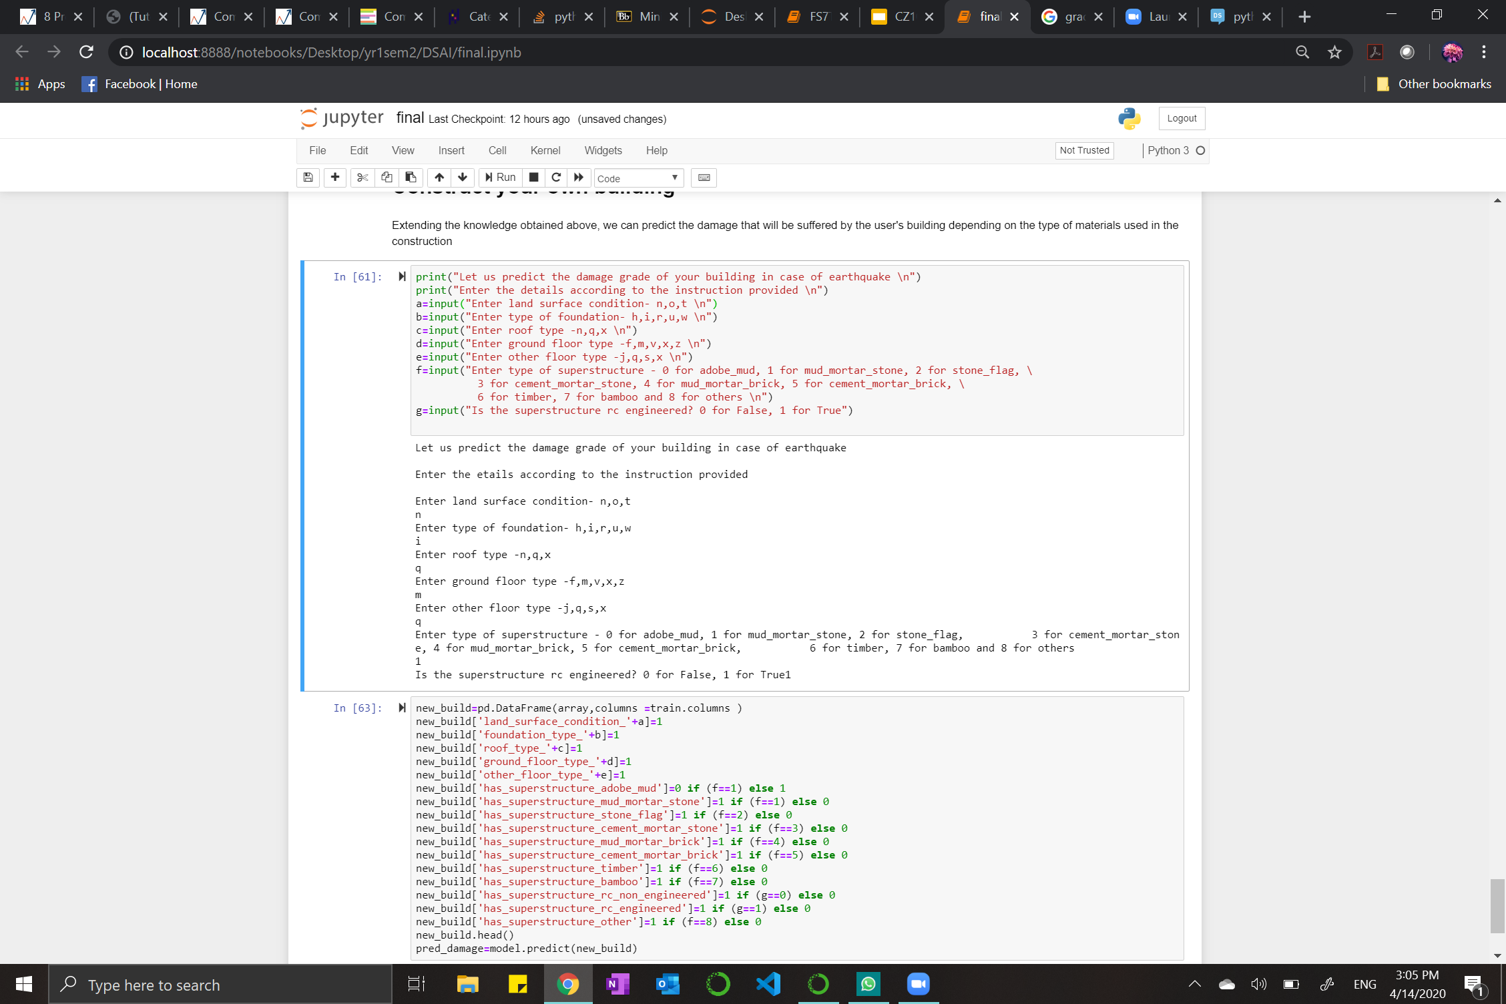
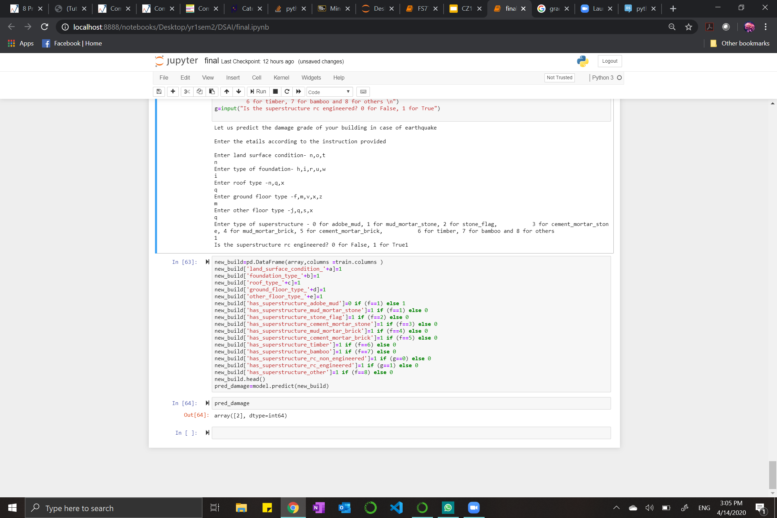
Construct your own building
Taking input from the user regarding the various building materials being used.
Predicted damage grade by using the XGBoost model trained earlier.

Slide 32
Conclusion

Slide 33
What are the most important factors which affect the damage grade of the buildings? | Predict the damage grade of the buildings by training the models based on the given dataset. | What are the ideal materials to be used in the construction that would suffer least damage? | Create your own building. Predict the damage it might suffer in case of earthquake.
In descending order: Foundation type = r Ground floor type = v Has superstructure mud mortar stone Geo level 1 id Foundation type = i Roof type = x Has superstructure cement mortar brick Foundation type = w Has superstructure stone flag Has superstructure mud mortar brick | Using our trained XGB Classifier model, we have predicted the damage grade of buildings of our test values. | The ‘ideal’ materials: Land surface condition = t Foundation type = i Roof type = x Ground floor type = v Other floor type = s superstructure = cement mortar brick and rc engineered | We allowed users to input various building materials and predicted damage grade using our XGB Classifier trained model.

Slide 34
Contributions
Chua Chiah Soon | Garg Astha | Ho Wei Yi Stanley | Nurul Afiqah Binte Aris
Problem Statements Data Cleaning and Preparation Statistical Analysis Machine Learning (GridSearchCV, SVM, Decision tree) Presentation | Problem Statements Data Exploration and Visualization Machine Learning (Decision Tree, Random Forest, Gradient Boosting, XGBoost) Identifying ‘ideal’ building materials Construct your own building Presentation | Problem Statements Data Cleaning and Preparation Data Exploration and Visualization Machine Learning (XGBoost and GridSearchCV) Presentation | Description of Dataset Presentation

Slide 35
Thank You!
Any questions?

